Slide 1
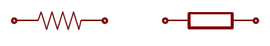
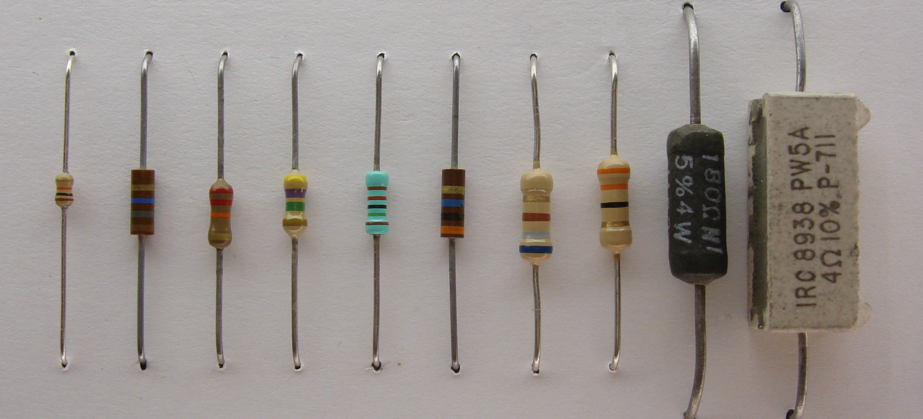
What is a resistor?
Resistors
American-Style Symbol
International-Style Symbol
Resistors limit the flow of electrons through a circuit by converting electrical energy to thermal energy (heat).
Resistors have no polarity so you can put them into a circuit in either orientation.
Resistors are characterized by their resistance value (in Ohms or Ω) and their maximum power capacity (in Watts), which is the maximum rate at which they can convert electrical energy to thermal energy.
¼ W resistors
½ W resistors
4 W
5 W
Source: https://learn.sparkfun.com/tutorials/resistors

Slide 2
What is a resistor?
Resistors
American-Style Symbol
International-Style Symbol
Resistors limit the flow of electrons through a circuit by converting electrical energy to thermal energy (heat).
Resistors have no polarity so you can put them into a circuit in either orientation.
Resistors are characterized by their resistance value (in Ohms or Ω) and their maximum power capacity (in Watts), which is the maximum rate at which they can convert electrical energy to thermal energy.
¼ W resistors
½ W resistors
4 W
5 W
Fastest
Slowest
Source: https://learn.sparkfun.com/tutorials/resistors

Slide 3
What is a resistor?
Resistors
American-Style Symbol
International-Style Symbol
Resistors limit the flow of electrons through a circuit by converting electrical energy to thermal energy (heat).
Resistors have no polarity so you can put them into a circuit in either orientation.
Resistors are characterized by their resistance value (in Ohms or Ω) and their maximum power capacity (in Watts), which is the maximum rate at which they can convert electrical energy to thermal energy.
¼ W resistors
½ W resistors
4 W
5 W
Source: https://learn.sparkfun.com/tutorials/resistors

Slide 4
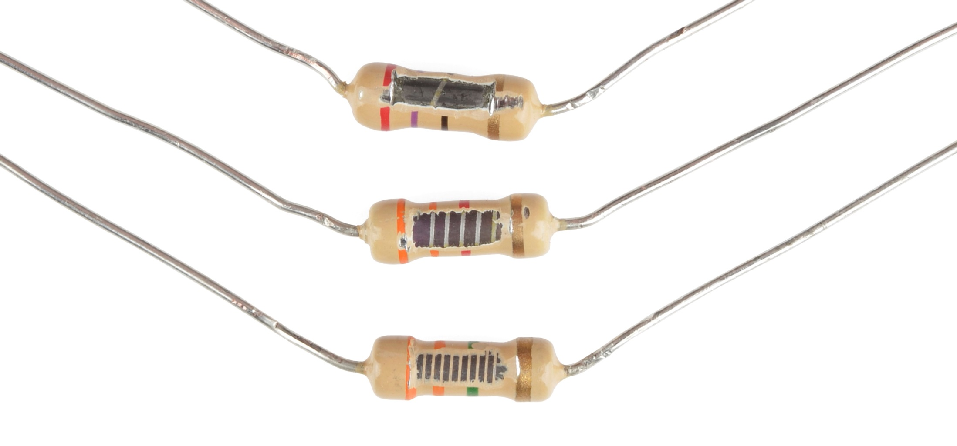
Resistor Composition
Resistors
Resistors are composed of a thin film of conductive material wrapped around an insulating material. The more wraps, the higher resistance. These are carbon film resistors with 5% tolerance
27Ω
330Ω
3.3MΩ
Source: https://learn.sparkfun.com/tutorials/resistors

Slide 5
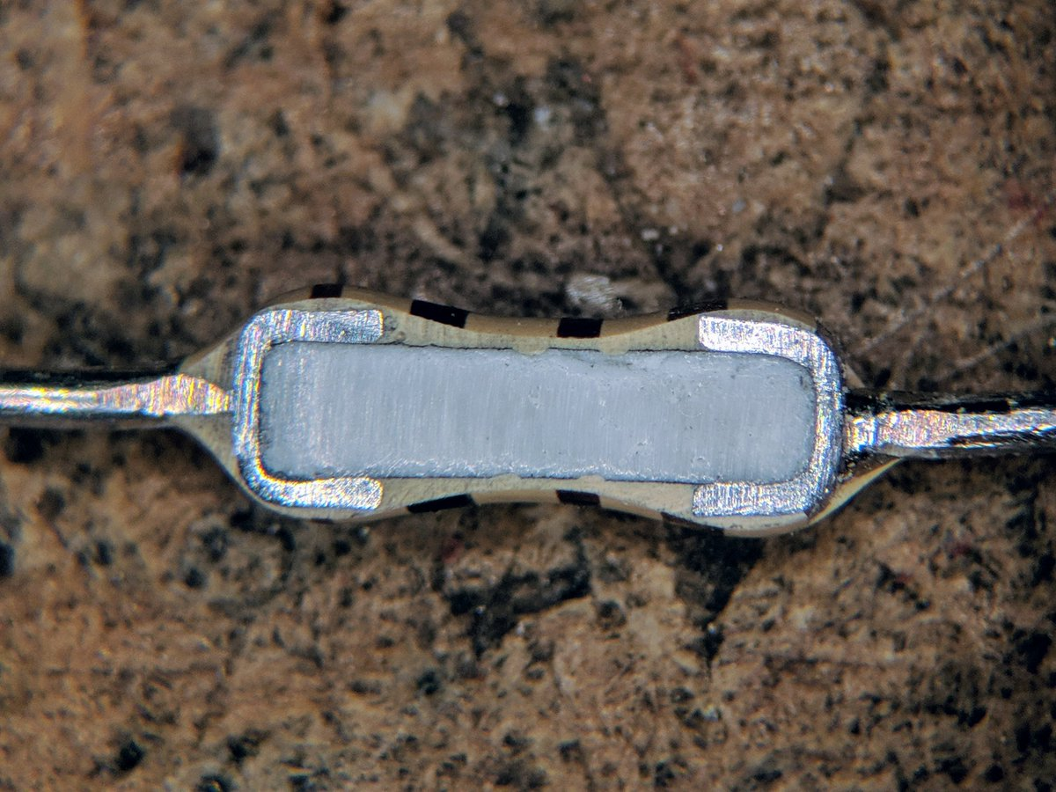
Resistors
Different style resistor…
Source: @TubeTimeUS, https://twitter.com/tubetimeus/status/1111785671650242560?s=11

Slide 6
Conductive contact
Conductive lead
Conductive lead
Resistive material
Insulating cover
Source: @TubeTimeUS, https://twitter.com/tubetimeus/status/1111785671650242560?s=11

Slide 7
Conductive contacts
Conductive lead
Conductive lead
Resistive material
Insulating cover
Source: @TubeTimeUS, https://twitter.com/tubetimeus/status/1111785671650242560?s=11

Slide 8
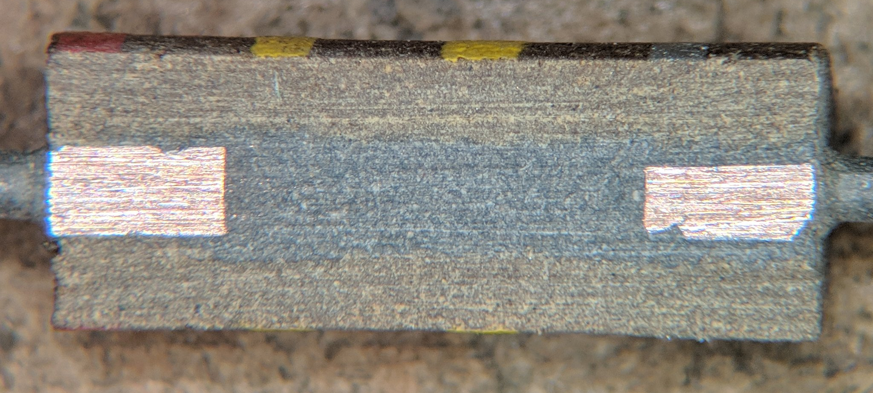
Conductive contacts
Conductive contacts
Conductive lead
Conductive lead
Resistive material
Resistive material
Insulating cover
Insulating cover

Slide 9
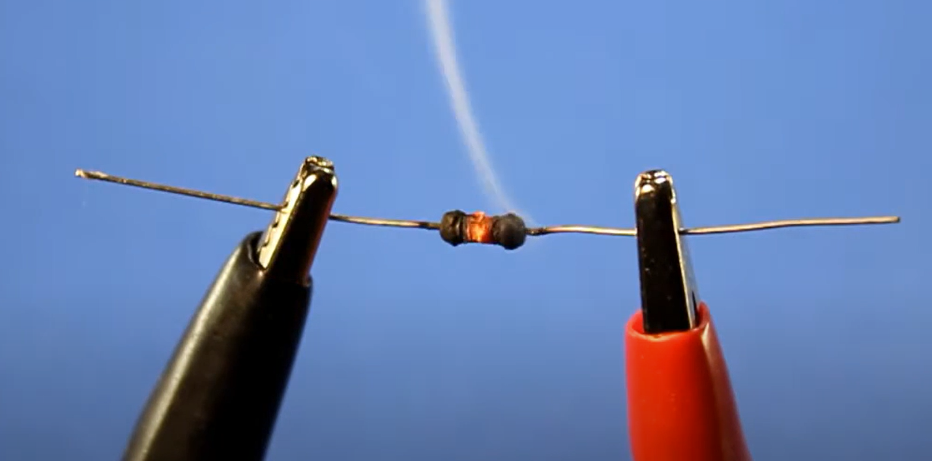
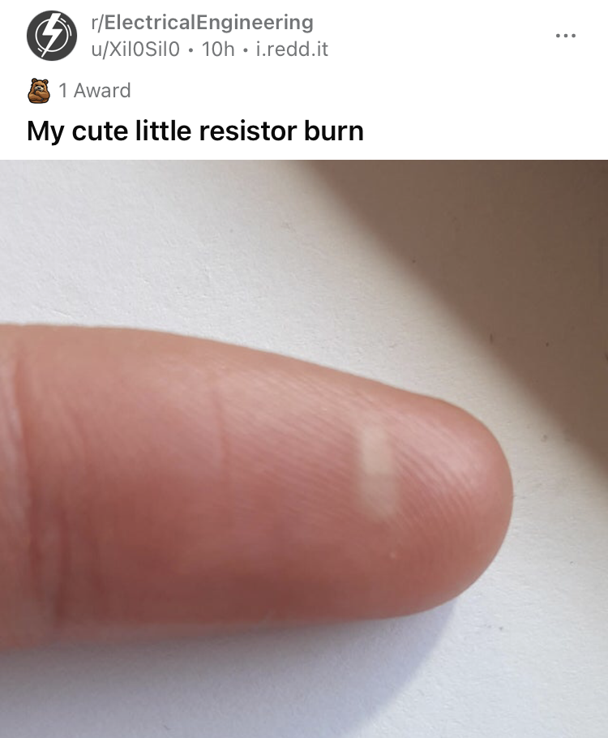

Slide 10
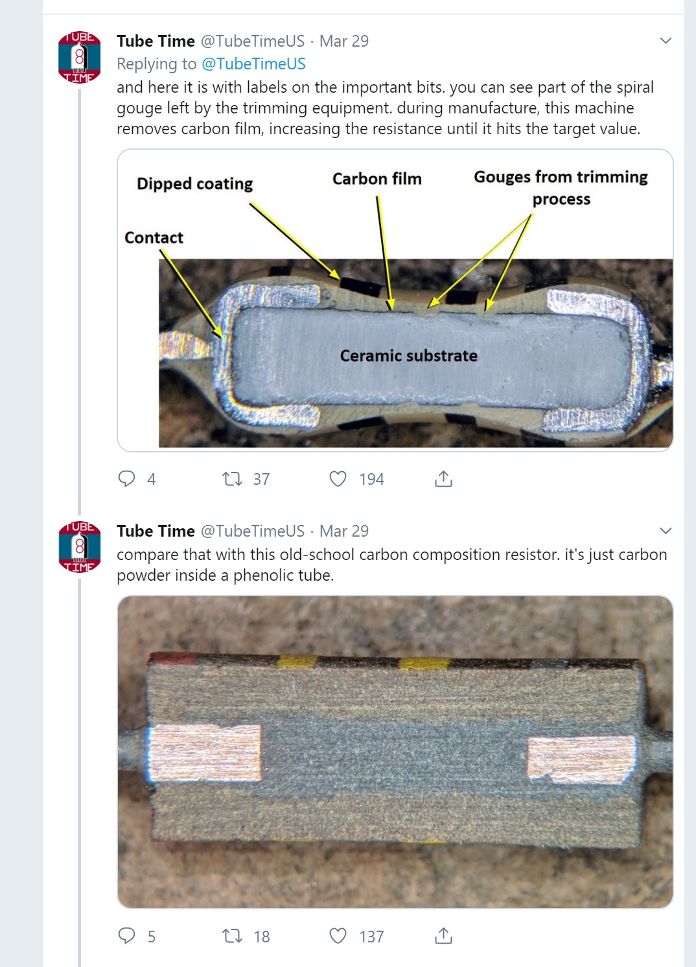
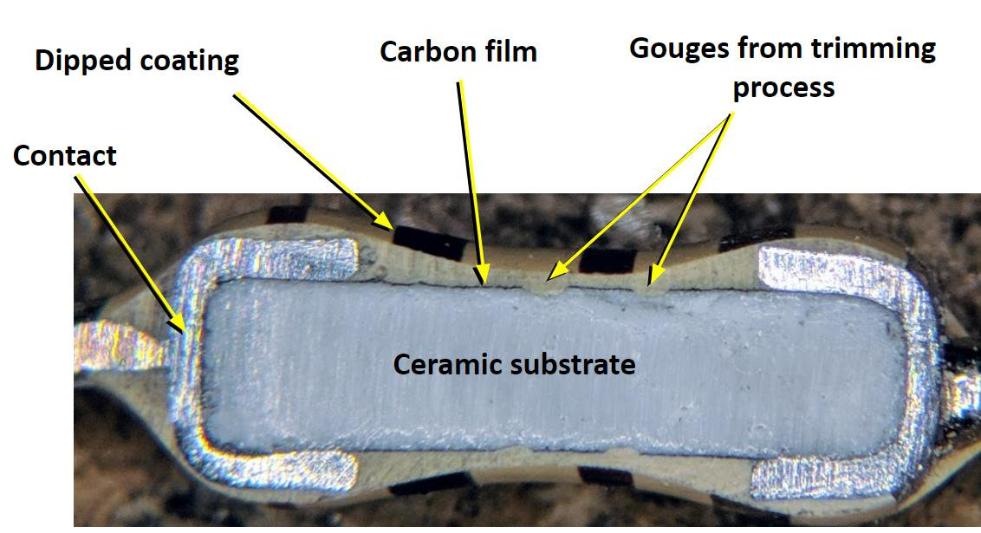

Slide 11
Notes:
https://twitter.com/tubetimeus/status/1111785671650242560?s=11

Slide 12
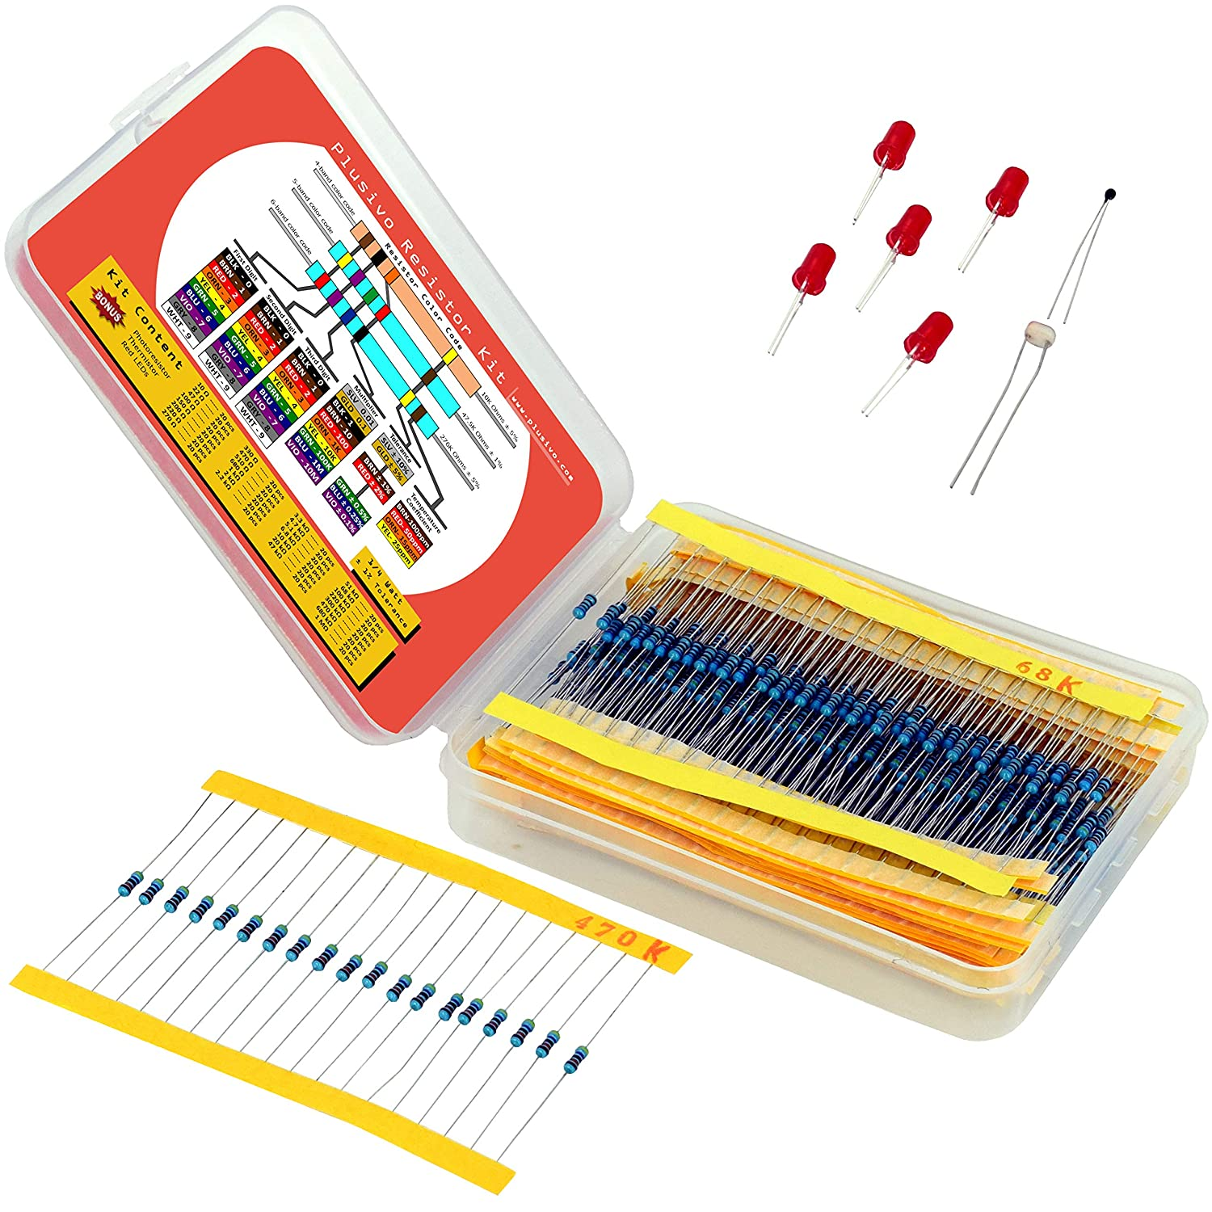
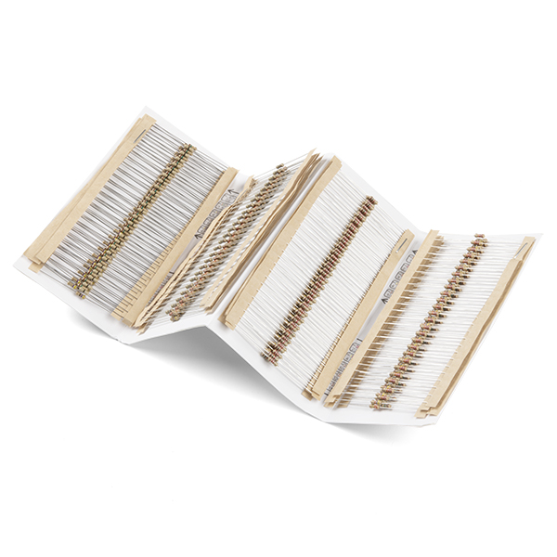
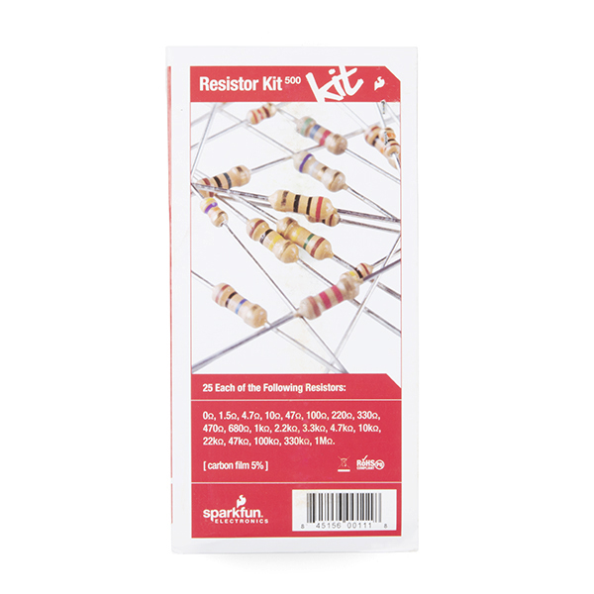
Sparkfun resistor kit
Plusivo resistor kit
Resistor kit with 1/4 W carbon film (±5% tolerance)
Resistor kit with 1/4 W metal film (±1% tolerance)

Slide 13
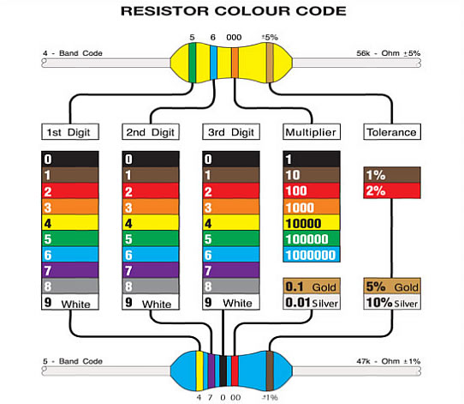
Multiplier
5
6
1000
= 56 * 1000 = 56kΩ (±5%)
Gold band indicates ±5% tolerance resistor
Brown band indicates ±1% tolerance resistor
4
= 470 * 100 = 47kΩ (±1%)
7
0
100
Multiplier

Slide 14
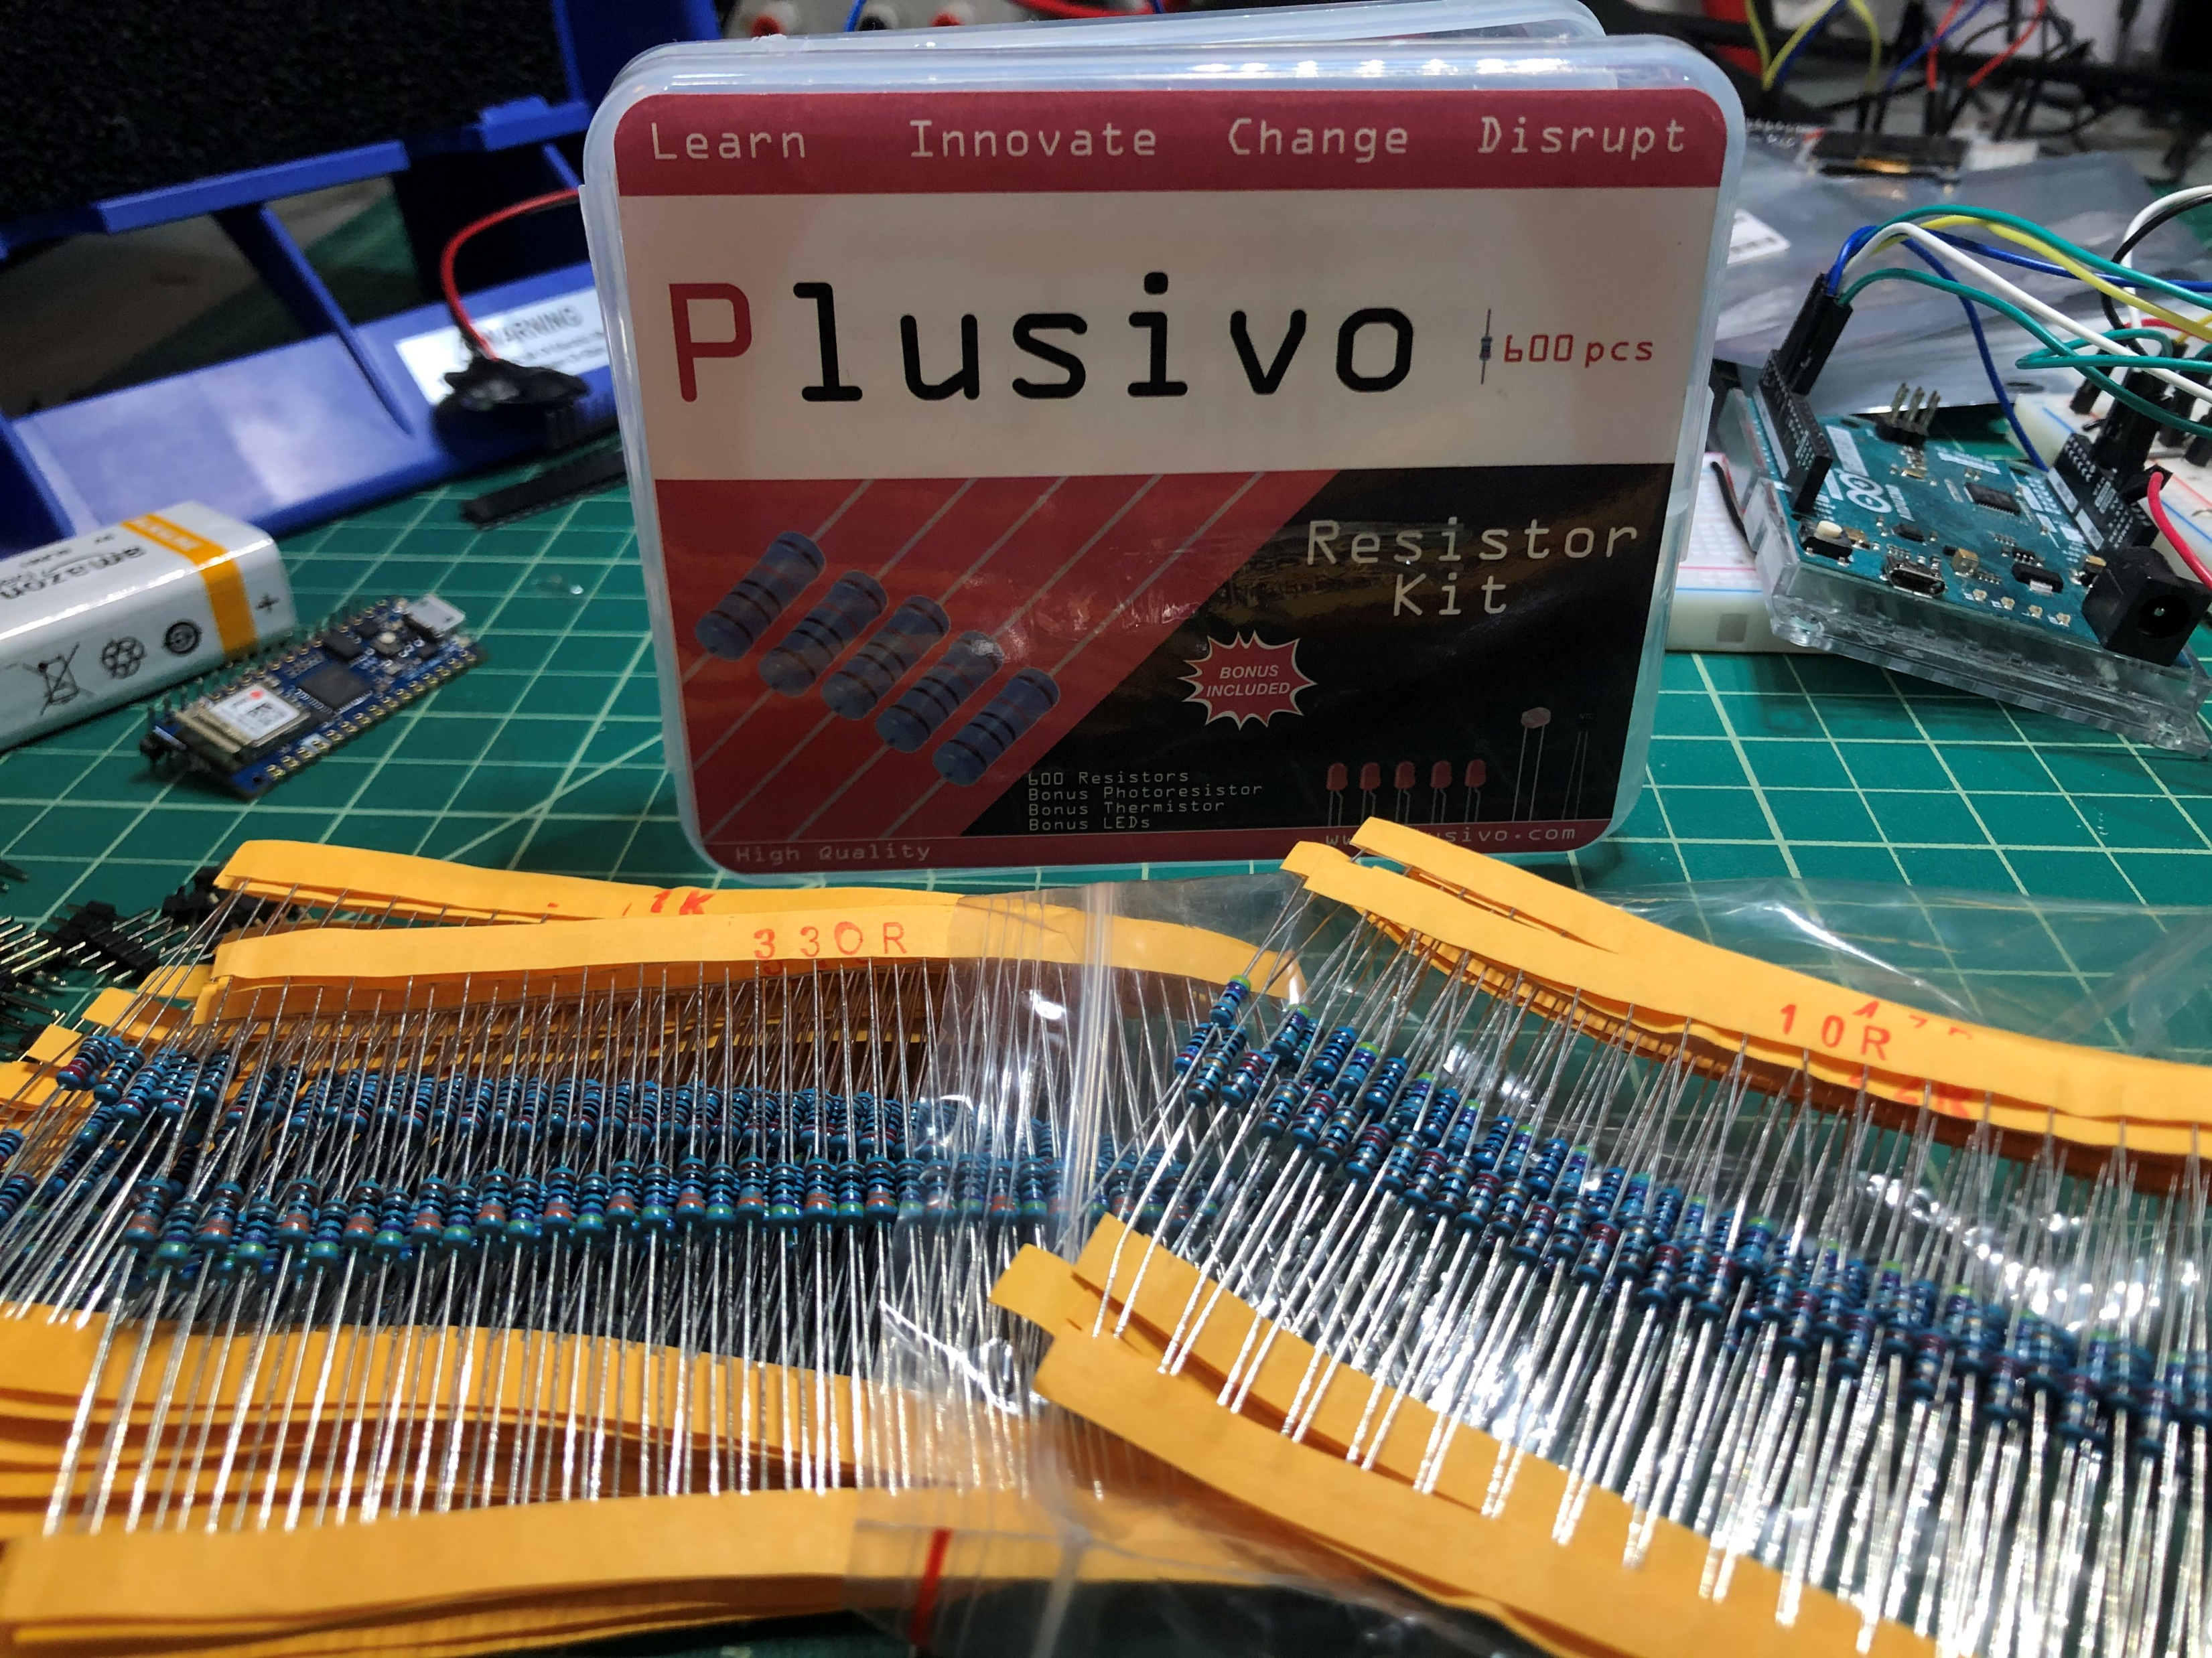
330 Ω Resistors
10 Ω Resistors

Slide 15
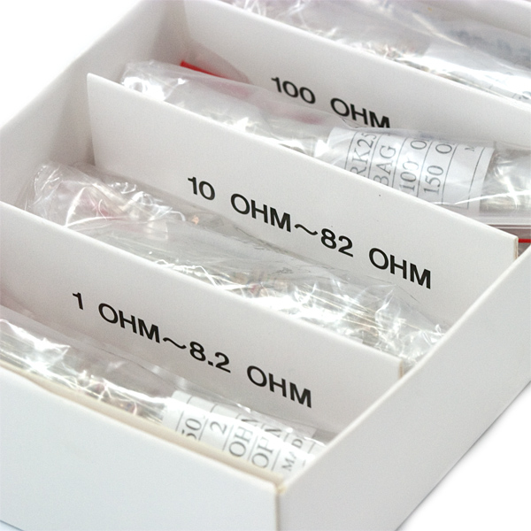
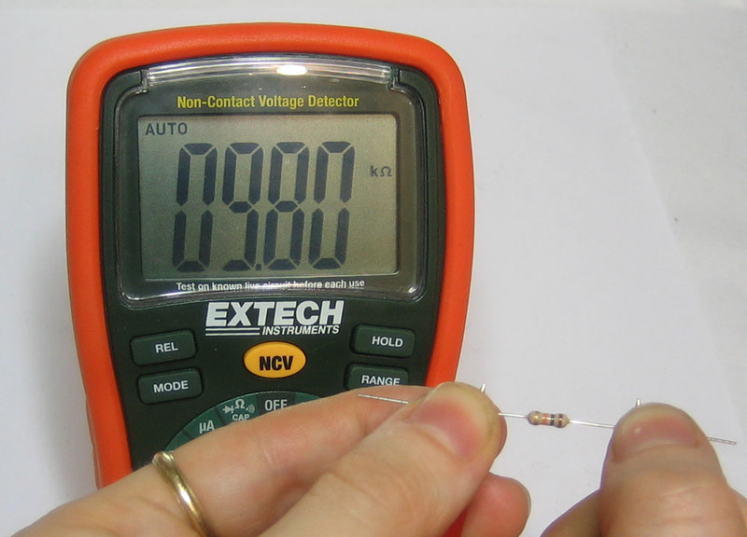
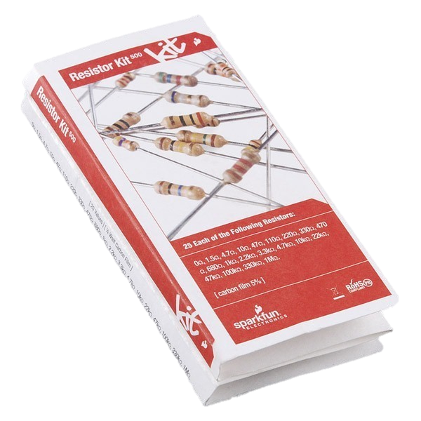
Three methods to read resistors
1. Keep Your Resistors Organized
I like kits like the SparkFun Resistor Kit, which comes organized by resistor value. Some kits have lil packets of resistors that are individually marked.
2. Resistor Chart (or from Memory)
You can also use a resistor chart (or your memory) but you still have to find the resistor you’re looking for! ☺
3. Use a Multimeter
Finally, you could use a multimeter to directly measure the resistance. Make sure that the resistor is not connected to anything else and switch the multimeter to its resistance measurement setting
Fastest
Slowest

Slide 16
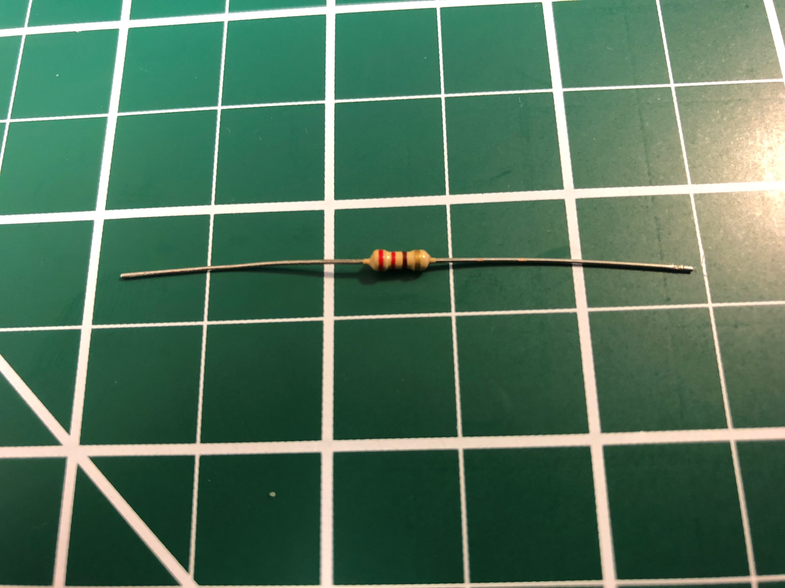
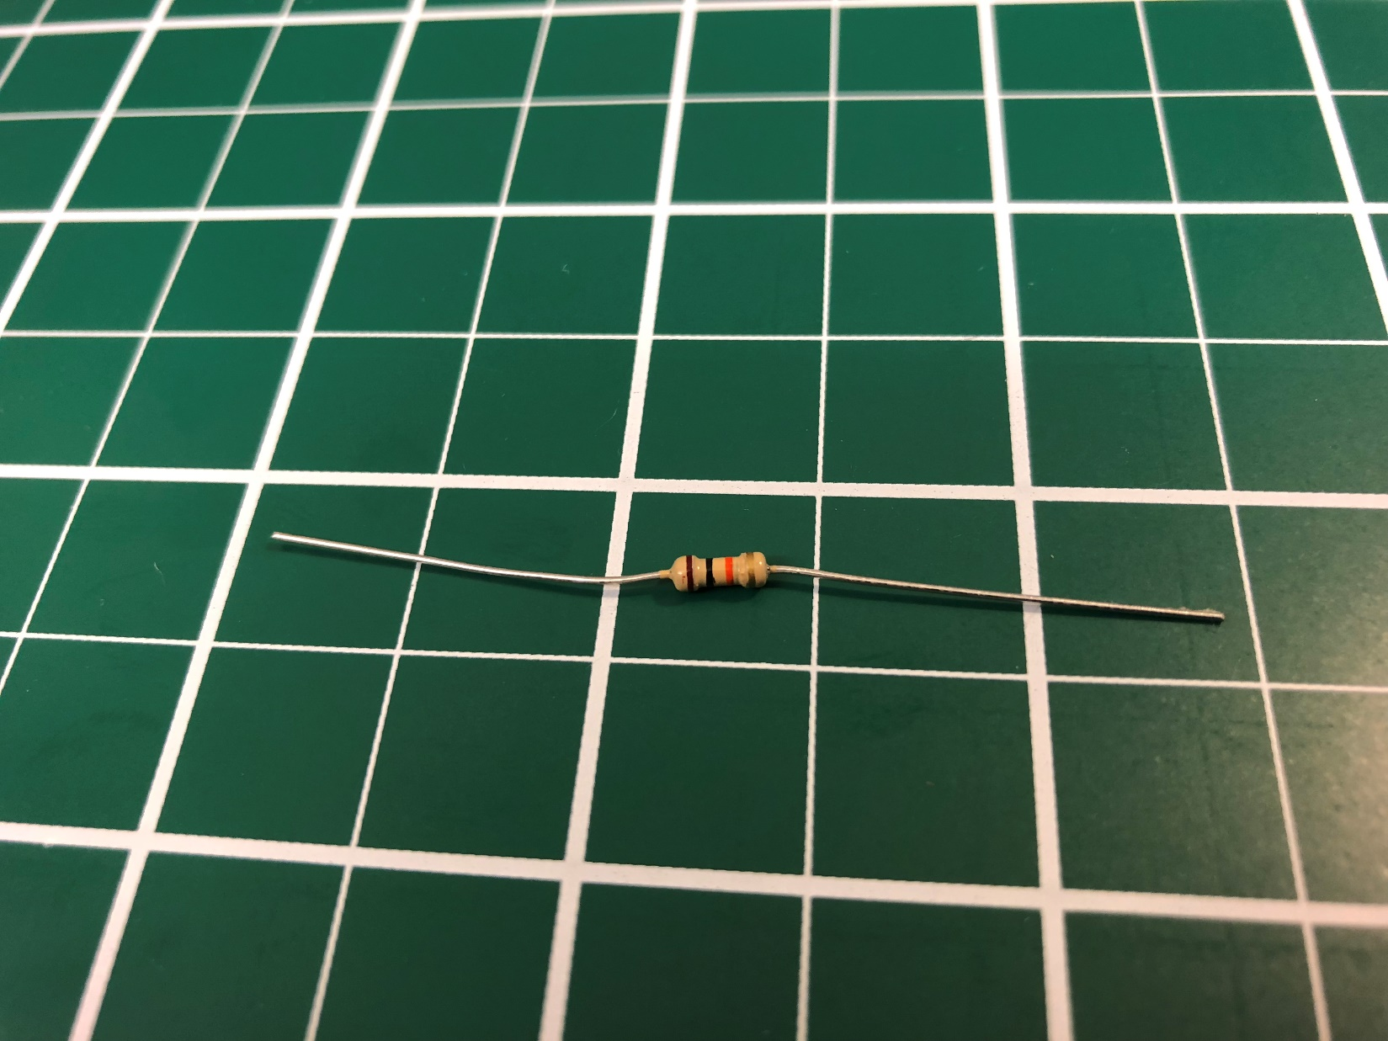
Exercise: Reading a resistor’s value
Resistors
Resistors have color-coded stripes indicating their resistance value
What is the value of this resistor?
Red, red, brown
What is the value of this resistor?
Brown, black, orange
Source: https://www.electro-tech-online.com/tools/images/cheat-sheets-resistor.gif

Slide 17
Reading a resistor’s value
Resistors
What is the value of this resistor? 220Ω
Red, red, brown= 2, 2, 10 = 22 * 10 = 220Ω
What is the value of this resistor? 10,000Ω or 10KΩ
Brown, black, orange, gold = 1, 0, 1000 = 10 * 1000 = 10KΩ
Source: https://www.electro-tech-online.com/tools/images/cheat-sheets-resistor.gif

Slide 18
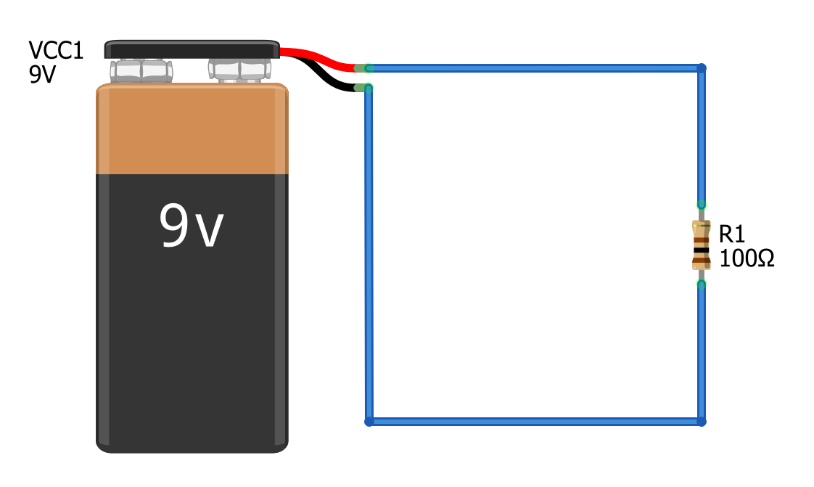
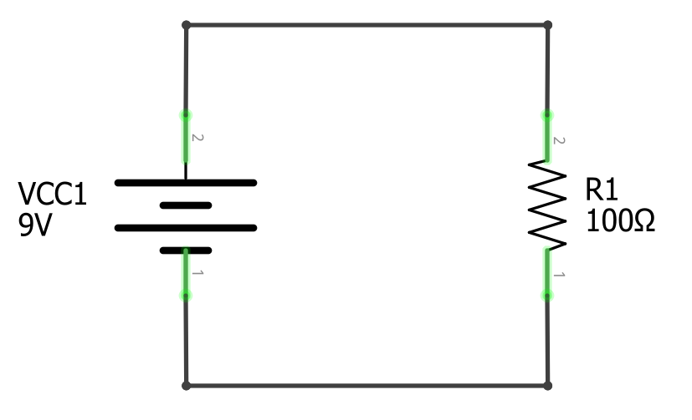
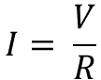
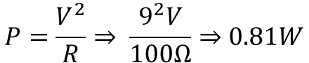
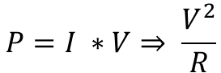
Ohm’s Law:
Power:
$$I= \frac{V}{R}$$
$$P=I ∗V⇒ \frac{V^{2}}{R}$$
$$P=\frac{V^{2}}{R}⇒ \frac{9^{2}V}{100Ω}⇒0.81W$$

